Slide 1
Local JO Partners meeting 21-22/4/2016

Slide 2
Industrial Survey Analysis Prof. Fahmi Abu Al Rub

Slide 3
Methodology
A Survey was prepared by ACI in collaboration with JUST and the Quality Committee leader; Creative Thinking.
The survey comprises of three sections:
1. General: which includes data about the company, the respondent, etc.
2. Previous experience with universities: which includes evaluation of previous experience of the respondent with the industry
3. The needs of the local industries

Slide 4
Methodology
JUST jointly with ASRF and MONOJO participated in two main workshops with the cosmetics industry and food industries. Invited industry representatives completed the survey
Most of the JO partners participated in the workshop organized by ACI with local industries to identify the needs of these industries. Participants from the industries completed the survey
JUST conducted one-on-one interviews with many industries in Amman and Irbid.
Total numbers of surveys collected = 125

Slide 5
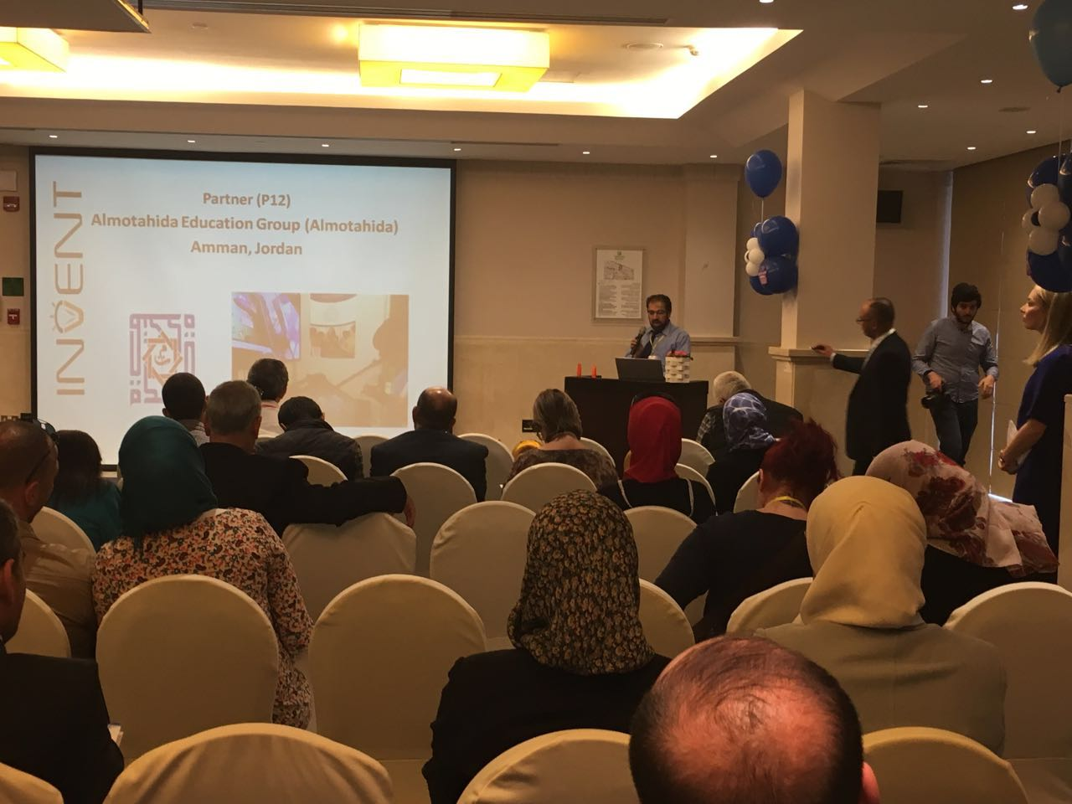
Cosmetics Industry Workshop Dead Sea

Slide 6
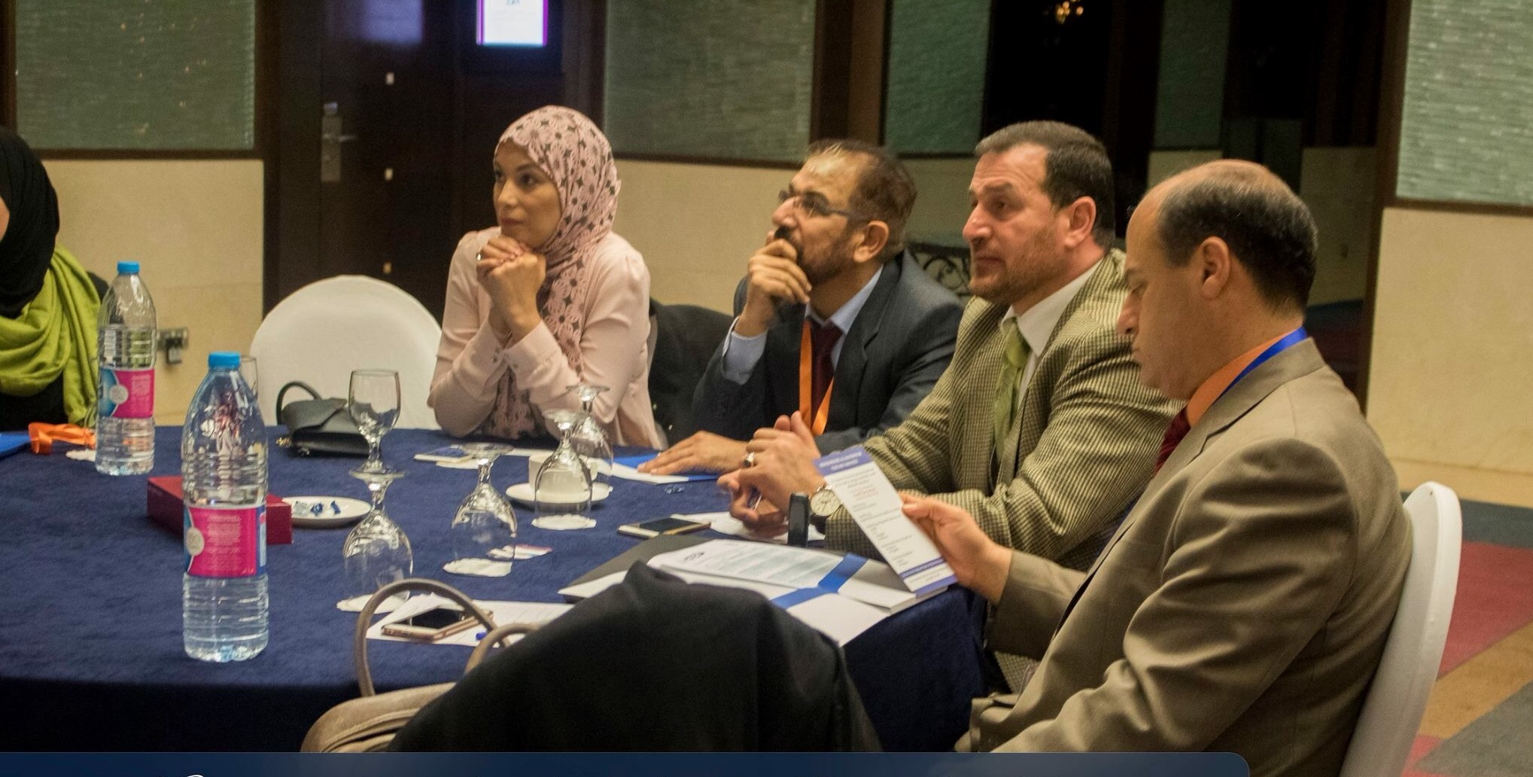
Food Industries Workshop Crown Plaza, April 12-13, 2016, Amman

Slide 7
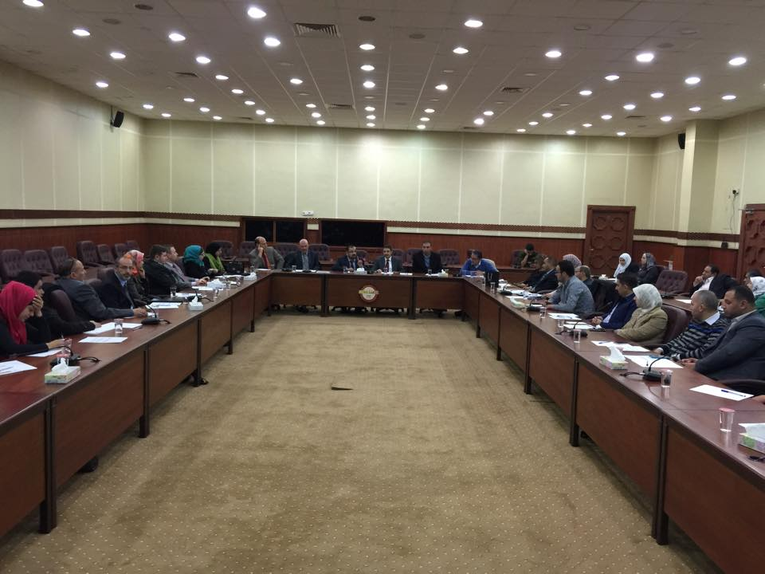
ACI workshop with local industries ACI, April 14, 2016, Amman
ACI Workshop with Local Industries ACI, April 13, 2016, Amman

Slide 8
ACI Workshop with Local Industries ACI, April 13, 2016, Amman

Slide 9
Q1: What is your position in the company?
More than 44% of the respondents represented the technical department

Slide 10
Q2: What is your academic qualification?
More than 55% of the respondents have BSc. degree

Slide 11
Q3: What is the size of your company in terms of the number of employees?
# of employees | %
1-9 | 16%
10-49 | 36%
50-250 | 46.4%
≥250 | 1.6 %

Slide 12
Q4: What is the field of your industry?

Slide 13
Q5: Does your company have a research and development department?
68% of the participated industries have R&D .

Slide 14
Q6: What is the annual average spending of your company on research and development (in Jordanian Dinars)?
About 90% of those who have R&D department spend less than JD 10,000/year on R&D.

Slide 15
Q7: Who initiated the first contact between you and the university?
57% of those who have previous collaboration with universities indicated that the universities started the first contact

Slide 16
Q8: What are the Area of collaboration between your company and university?
About 50% of collaboration with universities was through students training

Slide 17
Q9: how many projects (current or past) performed in partnership with a university?
More than 60% of the participants have only one project in collaboration with the universities

Slide 18
Q10: What was the average fund per project (in Jordanian Dinars)?
87% of the participants contributed with less than JD 1000 in the funded collaborated projects.

Slide 19
Q11: In your opinion, did the money spent by your company on this partnership benefit your business?
Only 21% of the participants indicated that the money spent benefited their companies

Slide 20
Q12: Was your experience with universities successful?
34% of the participants indicated that their experience with universities was successful

Slide 21
Q13: What are the reasons for unsuccessful experience?
31% answered Difficult to deal with the university admin, 31% different priorities,

Slide 22
Q14: What is the direct impact of collaboration with the universities?

Slide 23
Q15: Would you like to collaborate again with universities?
63% of the participants would like to collaborate again with the universities

Slide 24
Q16: What are the best ways to establish a partnership with universities?
27% of the participants indicate that the best way to establish partnerships with universities is through meetings with faculty members

Slide 25
Q17: Are you aware of TTO in Universities?
More than 75% of the participants indicated that they are not aware of the presence of TTOs at the universities

Slide 26
Q18: What are the services you need from TTO?
Services needed by the industry from the TTOs:
1. Awareness of modern technologies (24%)
2. Applied research to develop/upgrade products (23%)
3. Connect with other companies (17%)

Slide 27
Q19: What are the factors which help promotion of innovation and industrial inventions?
Factors to promote innovation and industrial inventions:
Establishment of TT centers (30%)
Improving communication and building trust (23%)
Improvement of mechanisms to promote applied research outcomes at universities

Slide 28
Q20: Are you interested to communicate with TTO at Universities?
96% of participants are interested to communicate with TTO at universities

Slide 29
Thank you

